Slide 1




Introduction to Statistics
Notes:
Good Morning everyone. Welcome to the session of Introduction to AIML
Today objective would be to know what is AIML, its imple-mentation along with type of models and its real life examples

Slide 2

My Journey
SDA Bocconi, Italy class of 2017 with Post Graduation in Analytics
Bachelor’s degree from NIT Surat, Schooling from K.V., where he was the house captain
10+ years of experience across L&T, Merck Pharmaceutical, OYO, Udaan & Zomato
Currently, Senior Manager at Zomato, working for Ads Monetization team
Notes:
A quick introduction about myself, I’m Shashank and I have 10+ yrs of work ex, I have worked with companies like L&T, merck, OYO, Udaan and currently working as a senior manager in Zomato. I passed out from NIT Surat in 2013 and I did post grad from SDA Bocconi in 2017

Slide 3














Notes:
Okay before we start Introduction to AIML session, can someone tell me what comes in your mind when you hear the word AIML.

Slide 4


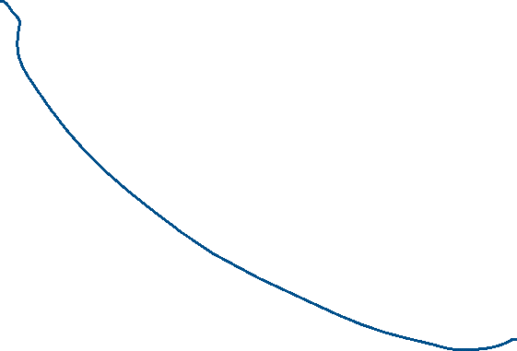






Notes:
Okay before we start Introduction to AIML session, can someone tell me what comes in your mind when you hear the word AIML.

Slide 5








Notes:
Okay before we start Introduction to AIML session, can someone tell me what comes in your mind when you hear the word AIML.

Slide 6





















Notes:
Okay before we start Introduction to AIML session, can someone tell me what comes in your mind when you hear the word AIML.

Slide 7






Notes:
Okay before we start Introduction to AIML session, can someone tell me what comes in your mind when you hear the word AIML.

Slide 8














Notes:
Okay before we start Introduction to AIML session, can someone tell me what comes in your mind when you hear the word AIML.

Slide 9














Notes:
Okay before we start Introduction to AIML session, can someone tell me what comes in your mind when you hear the word AIML.

Slide 10












Notes:
Okay before we start Introduction to AIML session, can someone tell me what comes in your mind when you hear the word AIML.

Slide 11


Notes:
Okay before we start Introduction to AIML session, can someone tell me what comes in your mind when you hear the word AIML.

Slide 12









Notes:
Okay before we start Introduction to AIML session, can someone tell me what comes in your mind when you hear the word AIML.

Slide 13










Notes:
Okay before we start Introduction to AIML session, can someone tell me what comes in your mind when you hear the word AIML.

Slide 14
















Notes:
Okay before we start Introduction to AIML session, can someone tell me what comes in your mind when you hear the word AIML.

Slide 15






Notes:
Okay before we start Introduction to AIML session, can someone tell me what comes in your mind when you hear the word AIML.

Slide 16









Notes:
Okay before we start Introduction to AIML session, can someone tell me what comes in your mind when you hear the word AIML.

Slide 17







Notes:
Okay before we start Introduction to AIML session, can someone tell me what comes in your mind when you hear the word AIML.

Slide 18














Notes:
Okay before we start Introduction to AIML session, can someone tell me what comes in your mind when you hear the word AIML.

Slide 19

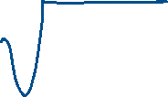






Notes:
Okay before we start Introduction to AIML session, can someone tell me what comes in your mind when you hear the word AIML.

Slide 20
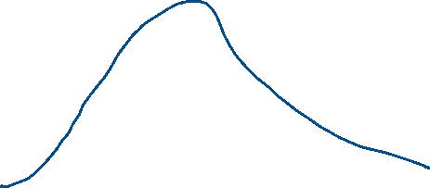





Notes:
Okay before we start Introduction to AIML session, can someone tell me what comes in your mind when you hear the word AIML.

Slide 21


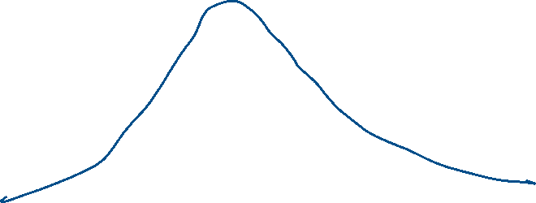


Notes:
Okay before we start Introduction to AIML session, can someone tell me what comes in your mind when you hear the word AIML.

Slide 22
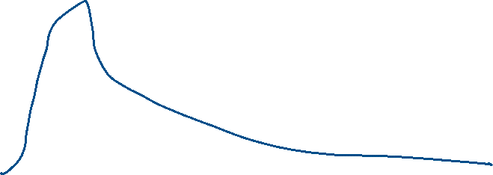






Notes:
Okay before we start Introduction to AIML session, can someone tell me what comes in your mind when you hear the word AIML.

Slide 23






Notes:
Okay before we start Introduction to AIML session, can someone tell me what comes in your mind when you hear the word AIML.

Slide 24







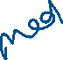








Notes:
Okay before we start Introduction to AIML session, can someone tell me what comes in your mind when you hear the word AIML.

Slide 25






















Notes:
Okay before we start Introduction to AIML session, can someone tell me what comes in your mind when you hear the word AIML.

Slide 26


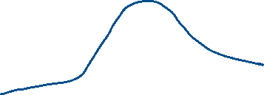


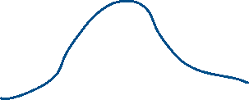



Notes:
Okay before we start Introduction to AIML session, can someone tell me what comes in your mind when you hear the word AIML.

Slide 27
Notes:
Okay before we start Introduction to AIML session, can someone tell me what comes in your mind when you hear the word AIML.

Slide 28
Notes:
Okay before we start Introduction to AIML session, can someone tell me what comes in your mind when you hear the word AIML.

Slide 29
Notes:
Okay before we start Introduction to AIML session, can someone tell me what comes in your mind when you hear the word AIML.

Slide 30
Notes:
Okay before we start Introduction to AIML session, can someone tell me what comes in your mind when you hear the word AIML.

Slide 31
Notes:
Okay before we start Introduction to AIML session, can someone tell me what comes in your mind when you hear the word AIML.

Slide 32
Notes:
Okay before we start Introduction to AIML session, can someone tell me what comes in your mind when you hear the word AIML.

Slide 33
Notes:
Okay before we start Introduction to AIML session, can someone tell me what comes in your mind when you hear the word AIML.

Slide 34
Notes:
Okay before we start Introduction to AIML session, can someone tell me what comes in your mind when you hear the word AIML.

Slide 35
Notes:
Okay before we start Introduction to AIML session, can someone tell me what comes in your mind when you hear the word AIML.

Slide 36
Notes:
Okay before we start Introduction to AIML session, can someone tell me what comes in your mind when you hear the word AIML.

Slide 37
Notes:
Okay before we start Introduction to AIML session, can someone tell me what comes in your mind when you hear the word AIML.

Slide 38
Notes:
Okay before we start Introduction to AIML session, can someone tell me what comes in your mind when you hear the word AIML.

Slide 39
Notes:
Okay before we start Introduction to AIML session, can someone tell me what comes in your mind when you hear the word AIML.

Slide 40








Notes:
Okay before we start Introduction to AIML session, can someone tell me what comes in your mind when you hear the word AIML.

Slide 41

Q. What are the three main measures of central tendency?
a) Mean, Variance, Mode
b) Mean, Median, Mode
c) Range, Standard Deviation, Median
d) Mean, Range, Variance
Notes:
Okay before we start Introduction to AIML session, can someone tell me what comes in your mind when you hear the word AIML.

Slide 42



Q. How do you calculate the mean for the dataset: 5, 10, 15, 20?
a) 10
b) 15
c) 12.5
d) 20
Notes:
Okay before we start Introduction to AIML session, can someone tell me what comes in your mind when you hear the word AIML.

Slide 43

Q. What is the mode of the following dataset: 3, 5, 7, 5, 9, 11, 5?
a) 3
b) 7
c) 9
d) 5
Notes:
Okay before we start Introduction to AIML session, can someone tell me what comes in your mind when you hear the word AIML.

Slide 44





Q. If a dataset is {2, 4, 6, 8, 10}, what is its median?
a) 4
b) 6
c) 8
d) 10
Notes:
Okay before we start Introduction to AIML session, can someone tell me what comes in your mind when you hear the word AIML.

Slide 45
Q. If a dataset is {2, 4, 6, 8, 10}, what is its median?
a) 4
b) 6
c) 8
d) 10
Notes:
Okay before we start Introduction to AIML session, can someone tell me what comes in your mind when you hear the word AIML.

Slide 46


Q. Define range in statistics.
a) The difference between the highest and lowest values
b) The average of all values
c) The middle value in a dataset
d) The most frequently occurring value
Notes:
Okay before we start Introduction to AIML session, can someone tell me what comes in your mind when you hear the word AIML.

Slide 47









Q. In what scenario would the median be a better measure of central tendency than the mean?
a) When the data is symmetrically distributed
b) When the data contains outliers or is skewed
c) When the data has no mode
d) When all values are the same
Notes:
Okay before we start Introduction to AIML session, can someone tell me what comes in your mind when you hear the word AIML.

Slide 48



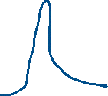
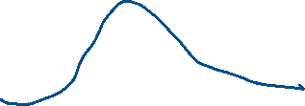



Q. How do you interpret a dataset with a high standard deviation compared to one with a low standard deviation?
a) High standard deviation means values are closely packed.
b) Low standard deviation means values are widely spread.
c) High standard deviation means values are widely spread.
d) Low standard deviation means the dataset has outliers.
Notes:
Okay before we start Introduction to AIML session, can someone tell me what comes in your mind when you hear the word AIML.

Slide 49










Q. Calculate the interquartile range (IQR) for the dataset: 10, 20, 30, 40, 50, 60, 70, 80.
a) 30
b) 40
c) 50
d) 60
Notes:
Okay before we start Introduction to AIML session, can someone tell me what comes in your mind when you hear the word AIML.

Slide 50
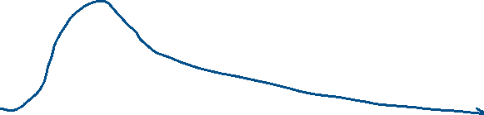







Q. Given a data distribution that is right-skewed, which measure of central tendency is most likely to be the largest?
a) Mean
b) Median
c) Mode
Notes:
Okay before we start Introduction to AIML session, can someone tell me what comes in your mind when you hear the word AIML.

Slide 51




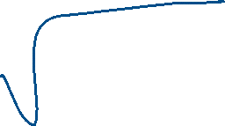





Q. A class of 20 students has the following scores: 45, 50, 55, 60, 65, 70, 75, 80, 85, 90, 95, 50, 55, 60, 65, 70, 75, 80, 85, 90. Calculate the standard deviation (approximation).
a) 10.2
b) 15.5
c) 12.3
d) 8.9
Notes:
Okay before we start Introduction to AIML session, can someone tell me what comes in your mind when you hear the word AIML.

Slide 52
Notes:
Okay before we start Introduction to AIML session, can someone tell me what comes in your mind when you hear the word AIML.

Slide 53
Notes:
Okay before we start Introduction to AIML session, can someone tell me what comes in your mind when you hear the word AIML.

Slide 54
Notes:
Okay before we start Introduction to AIML session, can someone tell me what comes in your mind when you hear the word AIML.

Slide 55
Notes:
Okay before we start Introduction to AIML session, can someone tell me what comes in your mind when you hear the word AIML.

Slide 56
Notes:
Okay before we start Introduction to AIML session, can someone tell me what comes in your mind when you hear the word AIML.

Slide 57
Notes:
Okay before we start Introduction to AIML session, can someone tell me what comes in your mind when you hear the word AIML.

Slide 58
Notes:
Okay before we start Introduction to AIML session, can someone tell me what comes in your mind when you hear the word AIML.

Slide 59
Notes:
Okay before we start Introduction to AIML session, can someone tell me what comes in your mind when you hear the word AIML.

